Slide 1
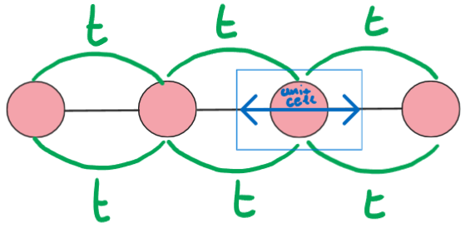
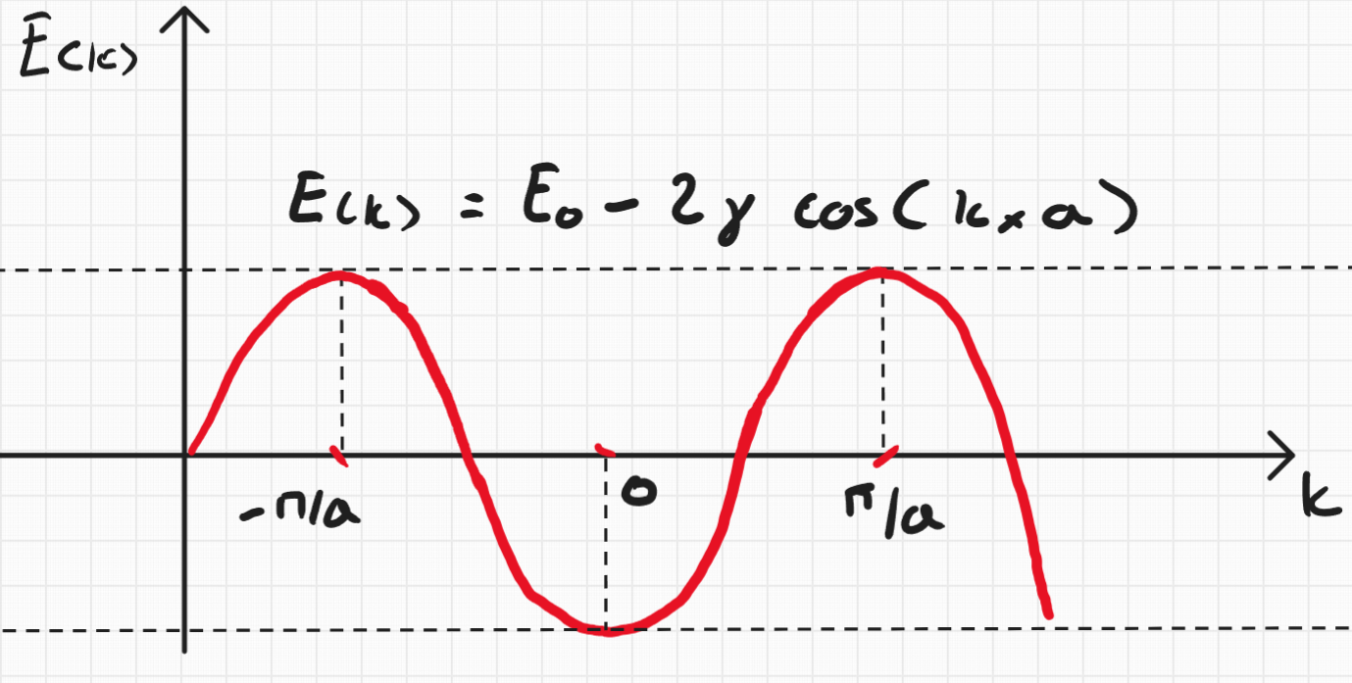
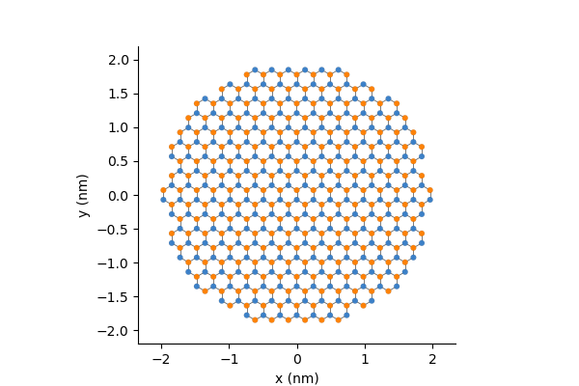
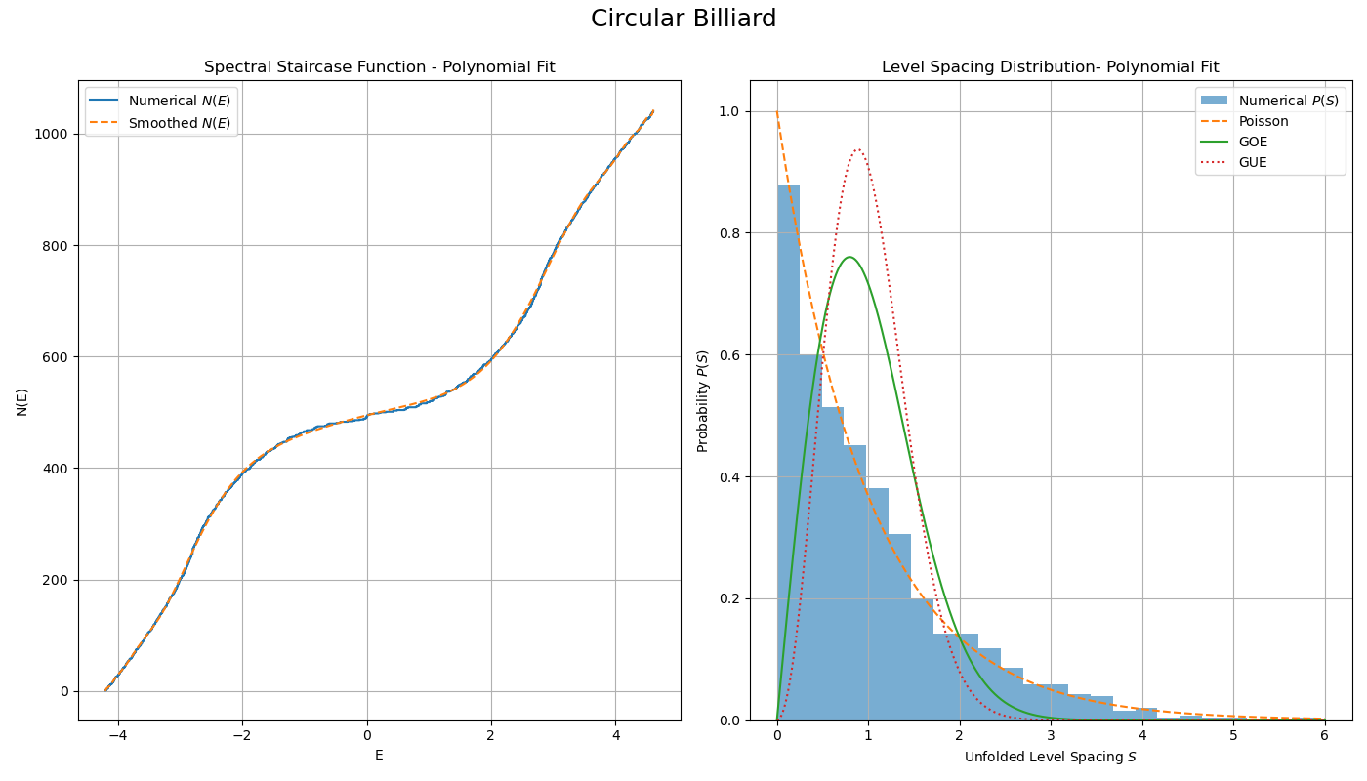
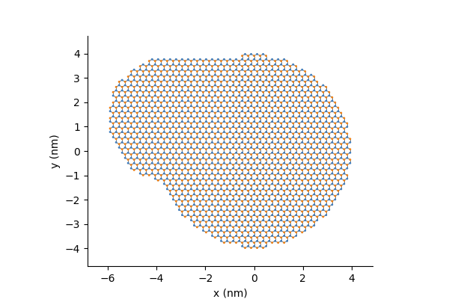
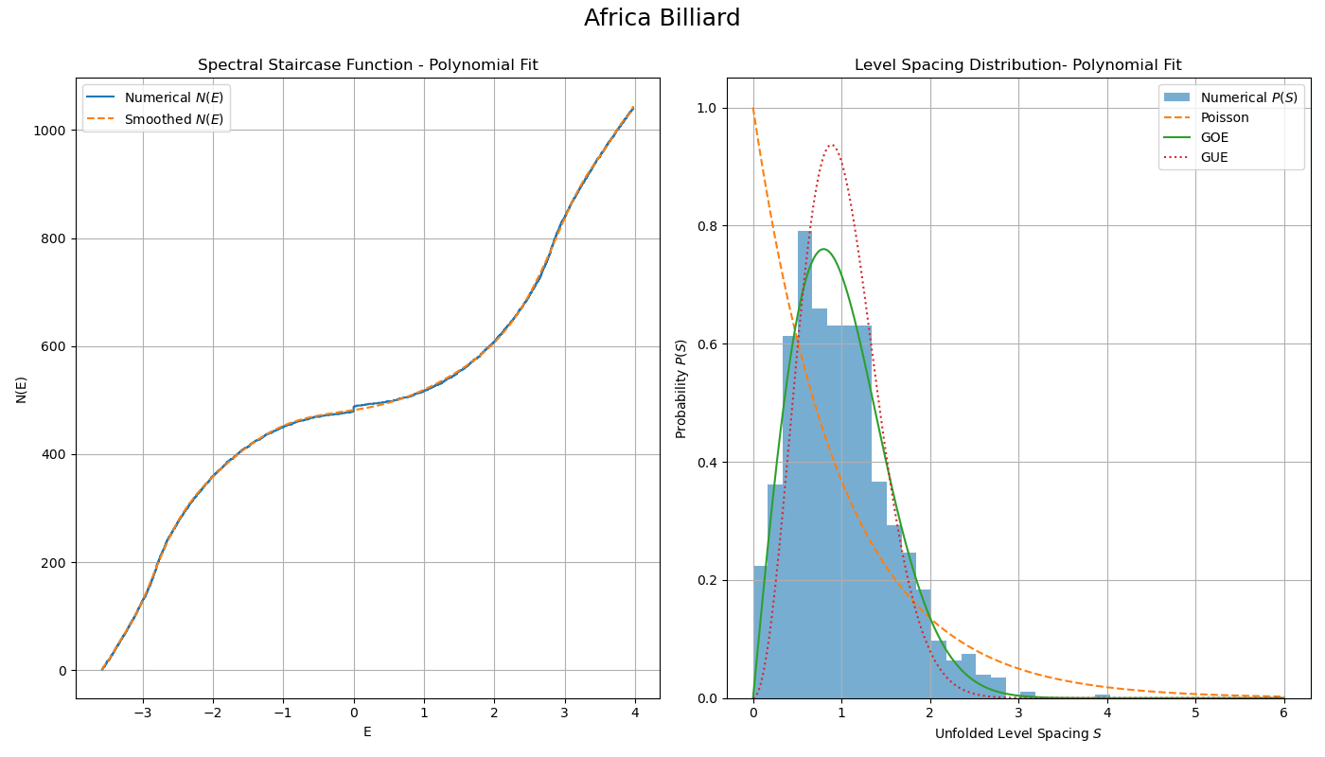
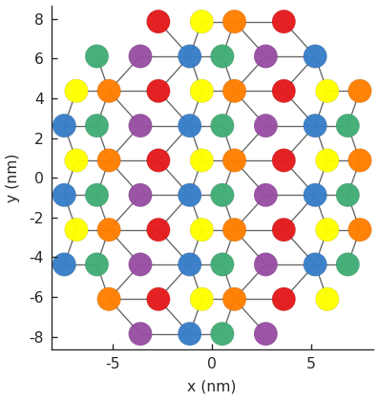
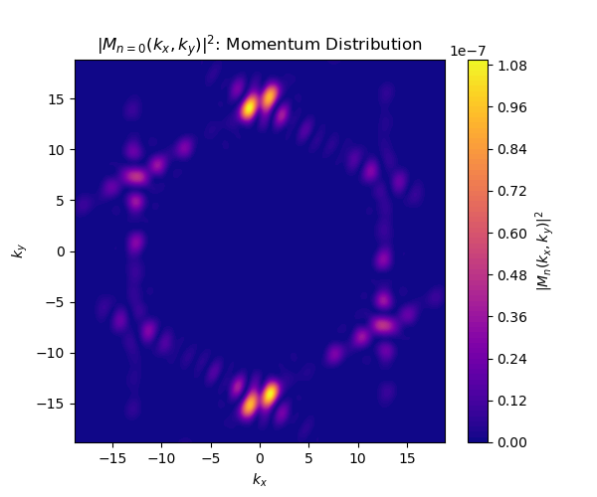
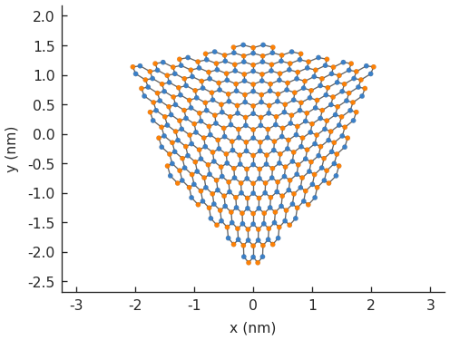
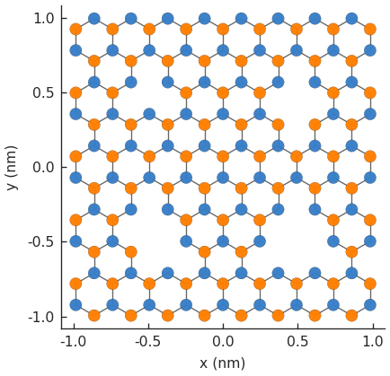
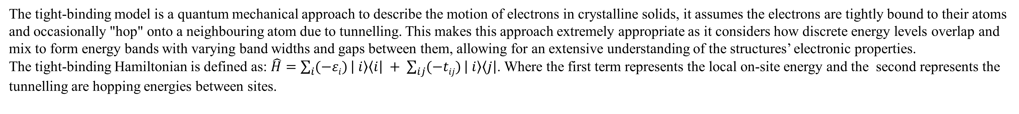
Properties of Topological Billiards
Topological billiards is an emerging research area at the intersection of solid-state physics, quantum chaos and materials science. These systems are built to study the behaviour of particles, usually electrons, confined in two-dimensional geometries – similar to a ball bouncing in billiard table. In such systems electron dynamics are heavily influenced by the shape and topology of the confining region. Regular geometries (such as circles or squares) produce predictable and integrable motion, whereas irregular shapes (such as stadiums or fractals) lead to more complex and chaotic behaviour, with direct consequences on the system’s quantum spectra. The introduction of materials such as graphene add another layer of complexity, in graphene electrons behave like massless Dirac particles with their wavefunctions being subject to Berry phase and pseudospin dynamics. When confined these systems exhibit interesting results such as the anomalous quantum hall effect, quantised conductance, and the transition between regular and chaotic spectral statistics, all sensitive to strain, defects, impurities, and potential fields.
Tight – Binding Model
The tight-binding model is a quantum mechanical approach to describe the motion of electrons in crystalline solids, it assumes the electrons are tightly bound to their atoms and occasionally "hop" onto a neighbouring atom due to tunnelling. This makes this approach extremely appropriate as it considers how discrete energy levels overlap and mix to form energy bands with varying band widths and gaps between them, allowing for an extensive understanding of the structures’ electronic properties.
The tight-binding Hamiltonian is defined as: $\hat{H}=\sum_{i}{(−εi)}\left| i\right\rangle \left\langle i\right| + \sum_{ij}{(−tij)}\left| i\right\rangle \left\langle j\right|$. Where the first term represents the local on-site energy and the second represents the tunnelling are hopping energies between sites.
The tight-binding model is used to explore topological features such as Berry phase and edge states, particularly in 2D materials like graphene and topological insulators.
The tight-binding model’s extreme flexibility allows for extensions to include external fields, strain and defects.
Models in this project are implemented using Pybinding, a Python library that facilitates the construction and simulation of tight-binding systems on arbitrary lattices.
1D chain of L lattice sites
Dispersion relation
Spectral Statistics
Circular graphene billiard – Regular dynamics
In this configuration the, boundary is a perfect circle, representing an integrable quantum system. The spectral statistics show that energy levels are uncorrelated, following a Poisson distribution.
This behaviour is expected from systems with predictable, non-chaotic dynamics, where the motion of electrons remains regular and exhibits minimal sensitivity to initial conditions.
Africa graphene billiard – Chaotic dynamics
The Africa-shaped billiard introduces geometrical asymmetry, which breaks integrability and induces quantum chaos. The spectral statistics follow a Gaussian Orthogonal Ensemble (GOE), indicating a level repulsion and correlations between energy levels. These are characteristic signatures of chaotic quantum systems, where electron dynamics become highly sensitive to initial conditions enabling the study of quantum ergodicity and wavefunction scarring.
Plan for the summer
Different Materials – 1T’ –WTe2
Momentum Distribution – Band Structure
Investigate the effects of strain
Investigate the effects of vacancies and impurities

